Slide 1


Biomedical Research in the Era of AI

Slide 2


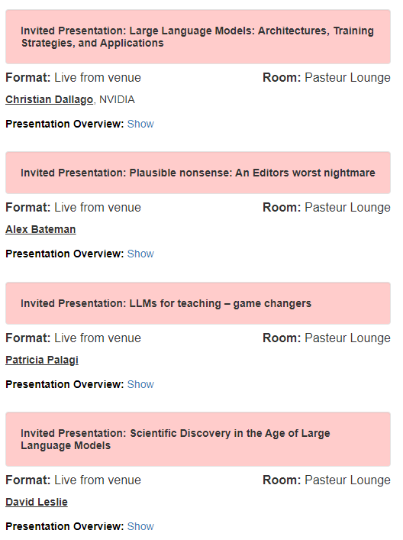
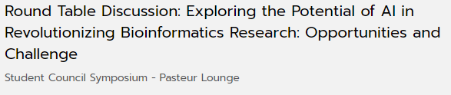


Slide 3
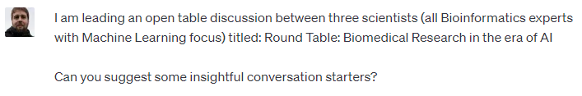
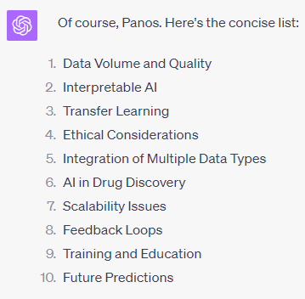

Slide 4
30 minutes per subject + 30 minutes free discussion
Initial position by each panel member (~5 mins) – followed by ~15 mins of free discussion
Training and Education
Ethical Considerations
Future Predictions

Slide 5

Training and Education

Slide 6

Ethical Considerations

Slide 7

Future Predictions

Slide 8
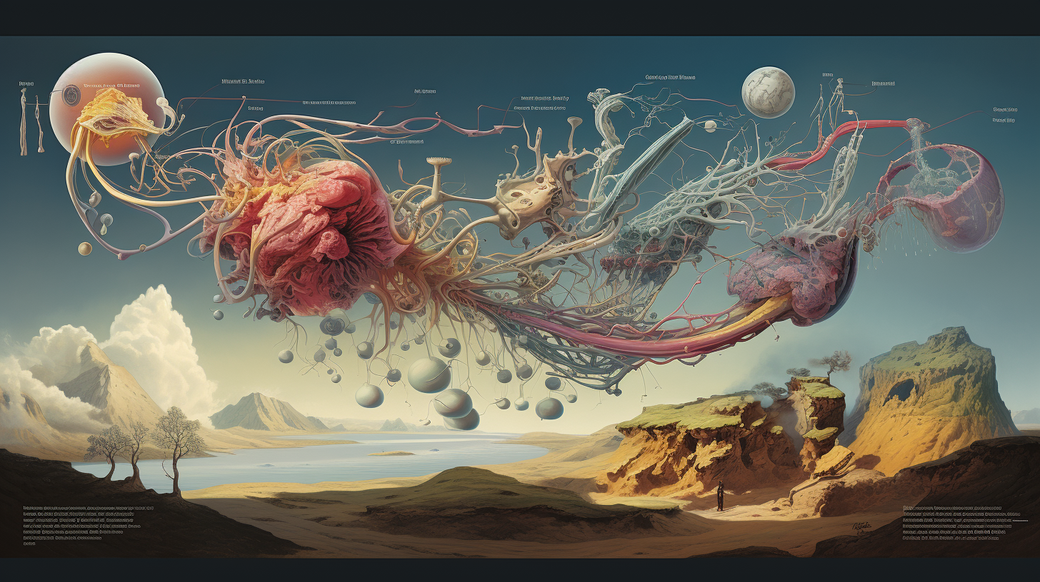
Free Discussion

